Slide 1
HAZE
BYTE
Wireframe
Group 1

Slide 2









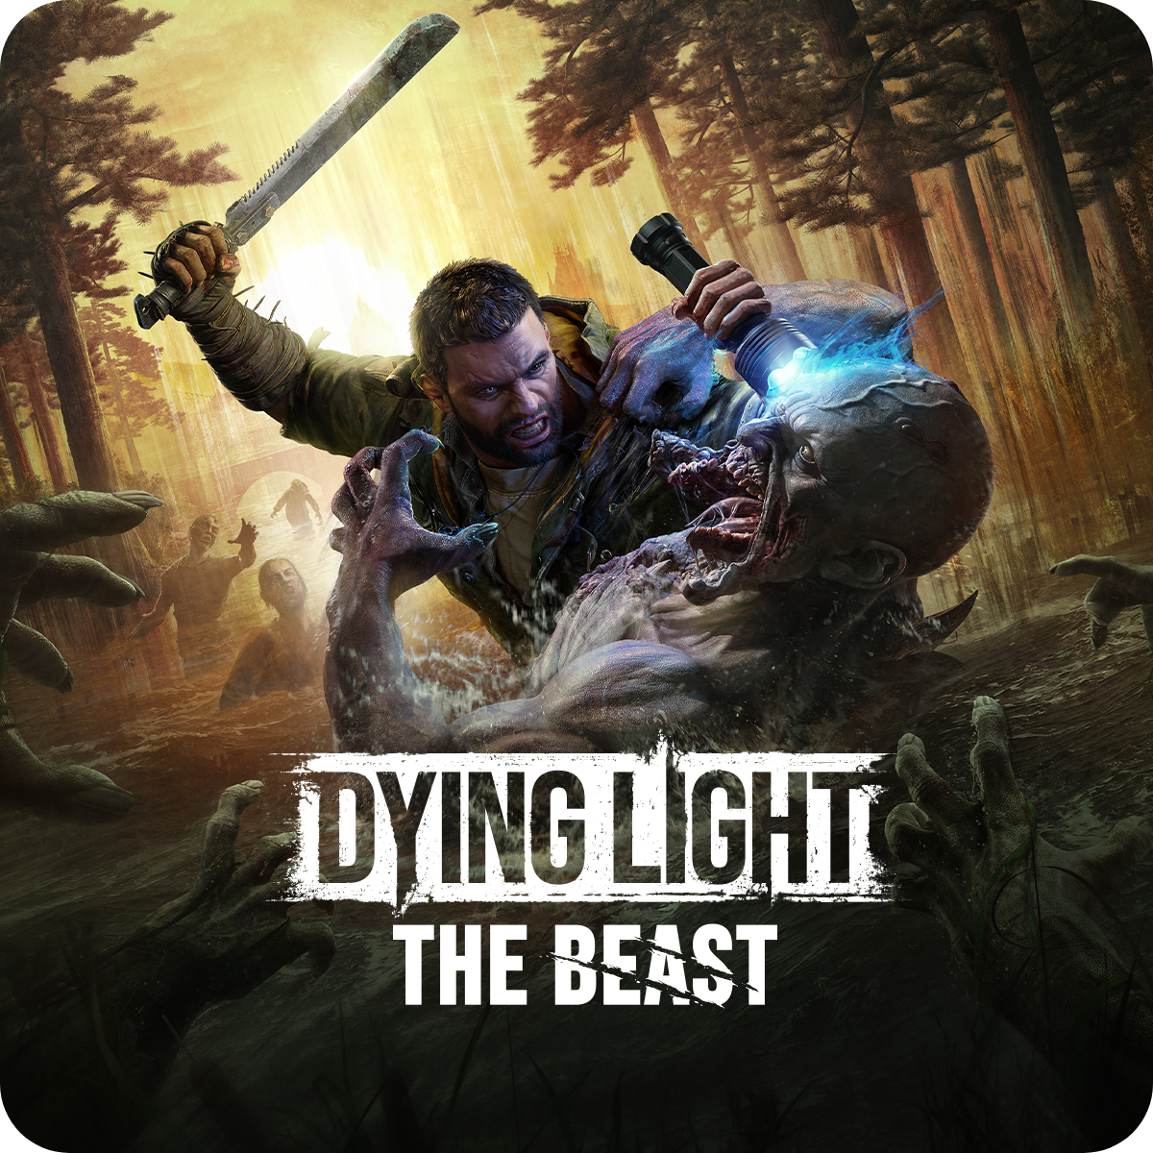











Games
Categories: all
Search…
Gacha game
Blue Archive
500$
Horror
Miside
456$
Action
Dying Light
806$
Adventure
Minecraft
978$
Gacha game
Zenless Zone Zero
500$
-
1
+
-
1
+
-
1
+
-
1
+
-
1
+
FPS
Call of Duty
769$
Adventure
GTA V
1755$
Action
Prototype 2
145$
FPS
Left 4 Dead
58$
Action
Warhammer 40k
40000$
-
1
+
-
1
+
-
1
+
-
1
+
-
1
+

Slide 3



Cart
Product Quantity Cost Total
Blue Archive 2 500$ 1000$
Left 4 Dead 1 58$ 58$
Gacha game
Blue Archive
500$
Description:
Blue Archive is a free-to-play real-time strategy role-playing game developed by South Korean developer MX Studio under the management umbrella of Nexon Games, a subsidiary of Nexon. It was released in 2021 for Android
Payment:
2000
Total Cost:
1058
2
Change:
942
1000$
Cancel all
Buy
Remove from cart

Slide 4
Cart
x
Receipt
Product Quantity Cost Total
Product Quantity Cost Total
-----------------------------------------------------------------------------------
Blue Archive 2 500$ 1000$
Left 4 Dead 1 58$ 58$
-----------------------------------------------------------------------------------
Payment: 2000
Total Cost: 1058
Change: 942
Thank you for buying in HazeByte!
Description:
Payment:
Total Cost:
Change:
Cancel all
Buy
Remove from cart

Slide 5
Edit Product Add Product
Search…
Name:
MiSide
Categories: all
Category:
Horror
456
Products:
Blue archive
Miside
Dying Light
Minecraft
Zenless Zone Zero
Call of Duty
GTA V
Prototype 2
Left 4 Dead
Warhammer 40k
Cost:
Description:
MiSide is an adventure game with horror elements, telling the story of a simple guy who, for mystical reasons, finds himself in a mobile simulation. Appearing in the house he has just observed on his smartphone screen, the hero becomes confused. The stunned guy follows the instructions of a certain device he discovered in the bedroom. A few moments later, he is greeted by a pretty girl, whose image is also familiar to the young man from this mobile game.
Delete
Save

Slide 6

Edit Product Add Product
Name:
Category:
none
Cost:
Description:
Cancel
Add

Slide 7
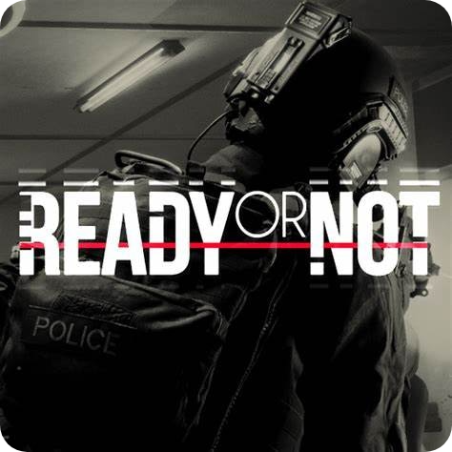
Edit Product Add Product
Name:
Ready or Not
Category:
FPS
Cost:
505
Description:
Ready or Not is a 2023 tactical first-person shooter video game developed and published by Ireland-based VOID Interactive and released for Microsoft Windows. Ready or Not follows the operations of a police SWAT team in the fictional American city of Los Sueños in the midst of a violent crime wave.
Cancel
Add

Slide 8
Transaction History
Categories: all
Search…
Product Category Quantity Cost Total Date Time
Blue Archive Gacha Game 2 500 1000 12/04/2025 17:05:03
Left 4 Dead FPS 1 58 58 12/04/2025 17:05:03
GTA V Adventure 1 1755 1755 12/03/2025 11:40:55
Zenless Zone Zero Gacha Game 6 10 60 12/01/2025 06:25:32
Dying Light Action 1 806 806 11/27/2025 21:11:30
Dying Light Action 3 806 2418 11/20/2025 08:50:10

Slide 9





Developer Info
Dev Team
Balungay, Anthony Miguel Cinco, Samuel James Custodio, Clark Derick
Payment Module Home Menu module Developer info module
Uayan, John Michael Vincent Bugayong, Elaiza
Add/Edit Module Transaction History Module
"I affirm that I have not given or received any unauthorized help on this assignment and that this work is my own".

